Slide 1
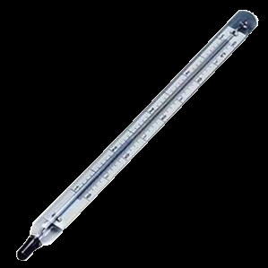

Exploring an ultracold Fermi-Fermi mixture of ⁶Li and ⁴⁰K
Florian Schreck

Slide 2
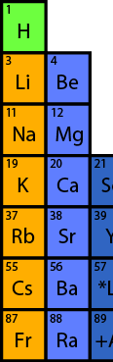
Ultracold alkali fermions
6
40
K
Li

Slide 3
Ultracold alkali fermions
6
&
40
K
Li

Slide 4

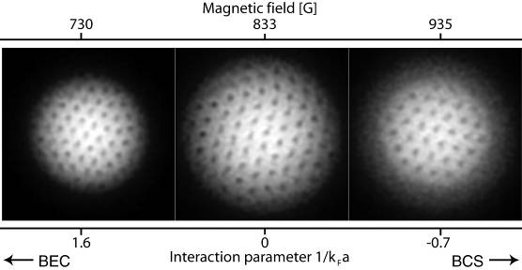
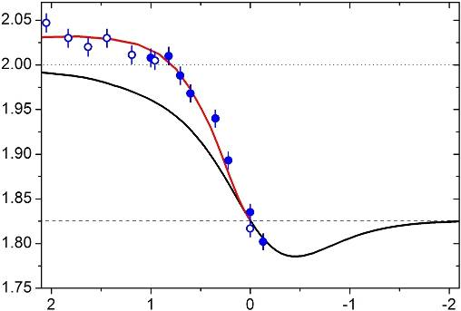
control knobs (single species)
BEC-BCS crossover physics
a
interaction strength
Innsbruck, JILA, MIT,
Duke, ENS, Rice
…
trap parameters:
anisotropy, ellipticity etc. (very flexible!)
physics of polarized Fermi gases
P
Rice
spin imbalance
MIT

Slide 5
new possibilities in FF mixtures
m₁/m₂
control of mass ratio
87/40 = 2.2
40/6 = 6.7
fermion pairing with unequal masses,
stable heteronuclear molecules,
novel quantum phases …
87/6 = 14.5
species #1
independent control of optical potentials
…
e.g., small trap of ⁴⁰K in a large trap of ⁶Li
or optical lattice for ⁴⁰K in a bath of ⁶Li …
species #2
…
Notes:
Alkaline – Alkaline Earth

Slide 6
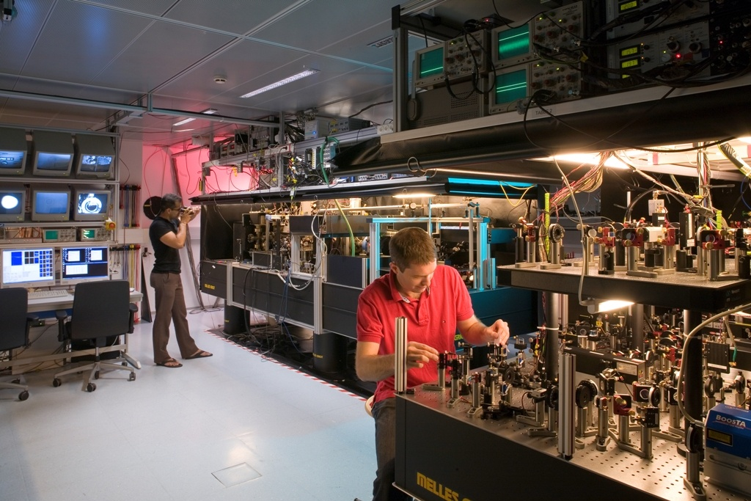
Notes:
Lets go to the lab and start doing something: all-optical production of degenerate Fermi mixture

Slide 7
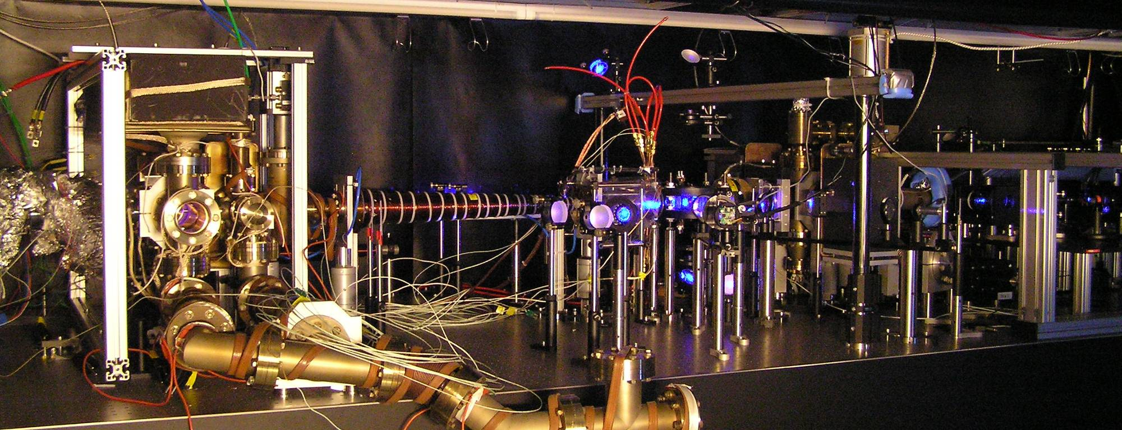
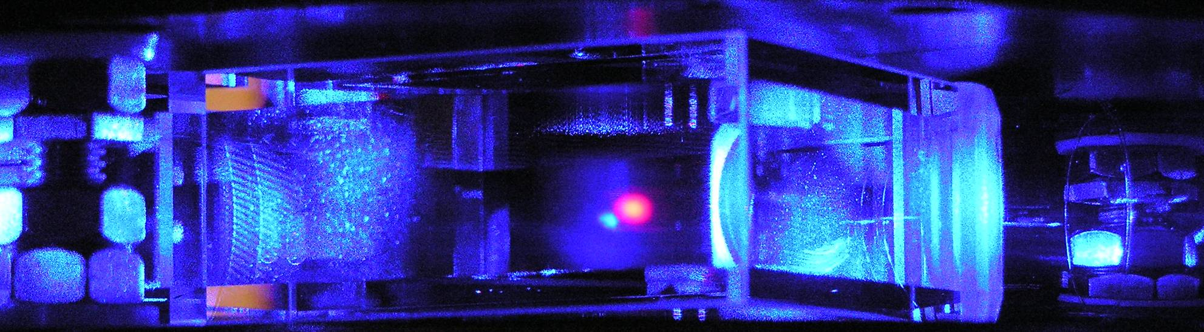
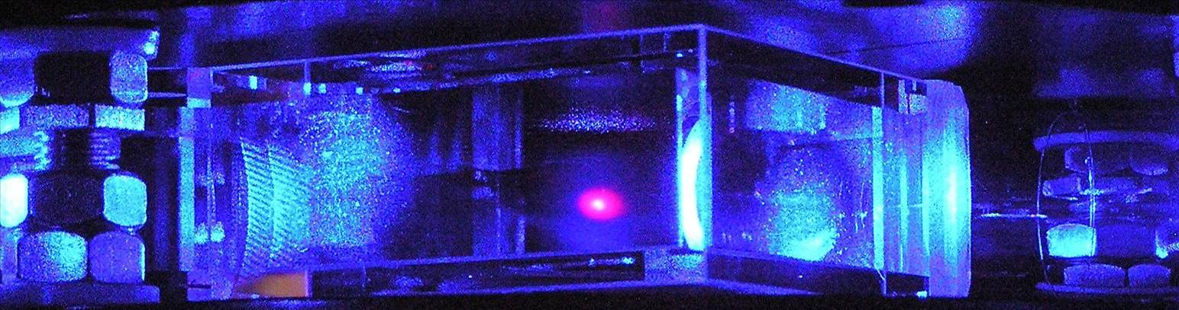
Lithium-Potassium-Strontium Machine

Slide 8
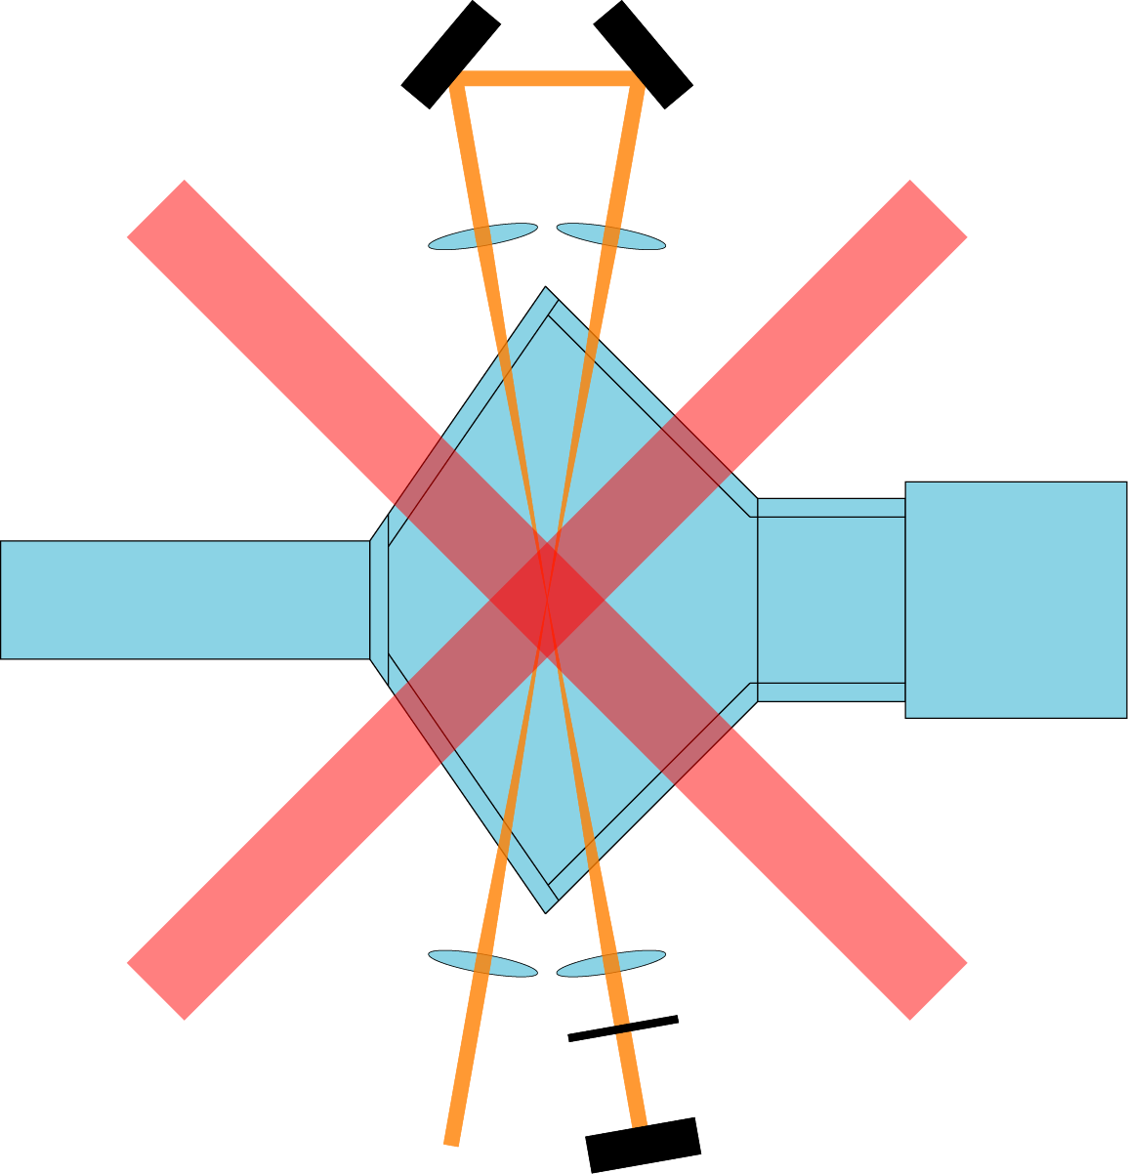
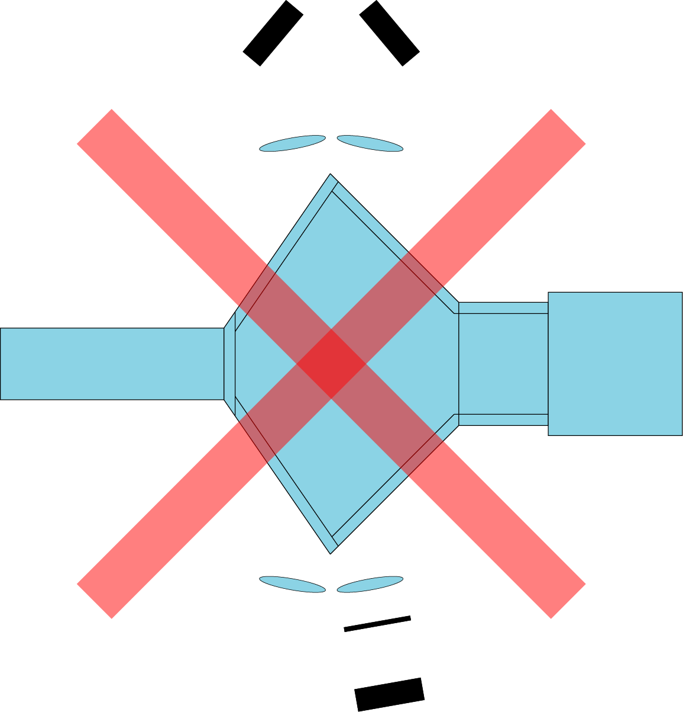
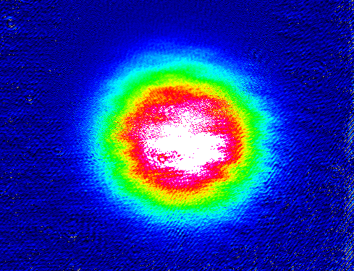
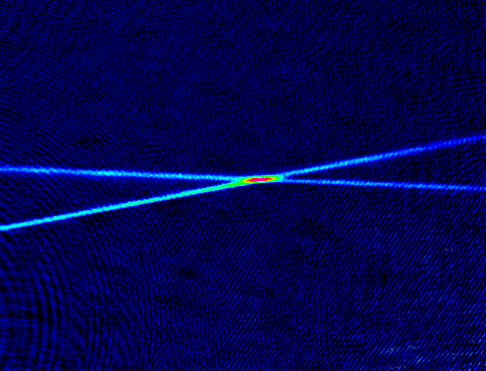
The all-optical way
⁶Li MOT: N ~ 10⁹ T ~ 300µK
MOT
beams
MOT
beams
3 mm
dipole trap: N > 10⁶
λ/4
3 mm
dipole trap (200W 1075nm laser):
U ~ k_{B} 1 mK
w ~ 30 µm
Notes:
Good starting point for evaporative cooling!
Feshbach search!

Slide 9


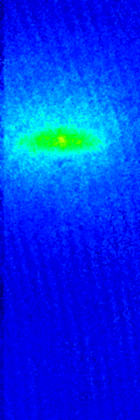
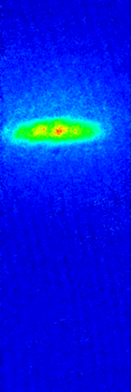
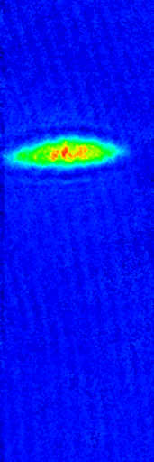
⁶Li₂ molecular Bose condensation
5.10⁵
molecules
in dipole trap
After 10ms time of flight:
PURE BEC!
4.3 sec evap
4.7 sec evap
4.8 sec evap
5.1 sec evap

Slide 10



heteronuclear FF mixture
Li|1>
Li|2>
K|1>
N = 4.5 10⁴
T = 70nK
T/T_{F}=0.2
N = 3.7 10³
T = 70nK
T/T_{F}=0.7
Degenerate heteronuclear Fermi-Fermi mixture
in the Lithium BCS regime (B = 1200G)

Slide 11

Stability of three-component
Fermi mixture

Slide 12
Stability
What happens in
our 3-Fermion mixture?
Formation of deeply bound molecules leads to loss
Energy & momentum conservation:
3 atom need to come closer than size of endstate
2 fermion mixture:
Pauli principle inhibits two of the three atoms to get close
PRL, 93, 090404
Notes:
Vibrational relaxation
Three-body recommbination to deeply bound state
Petrov/Shlyapnikov

Slide 13
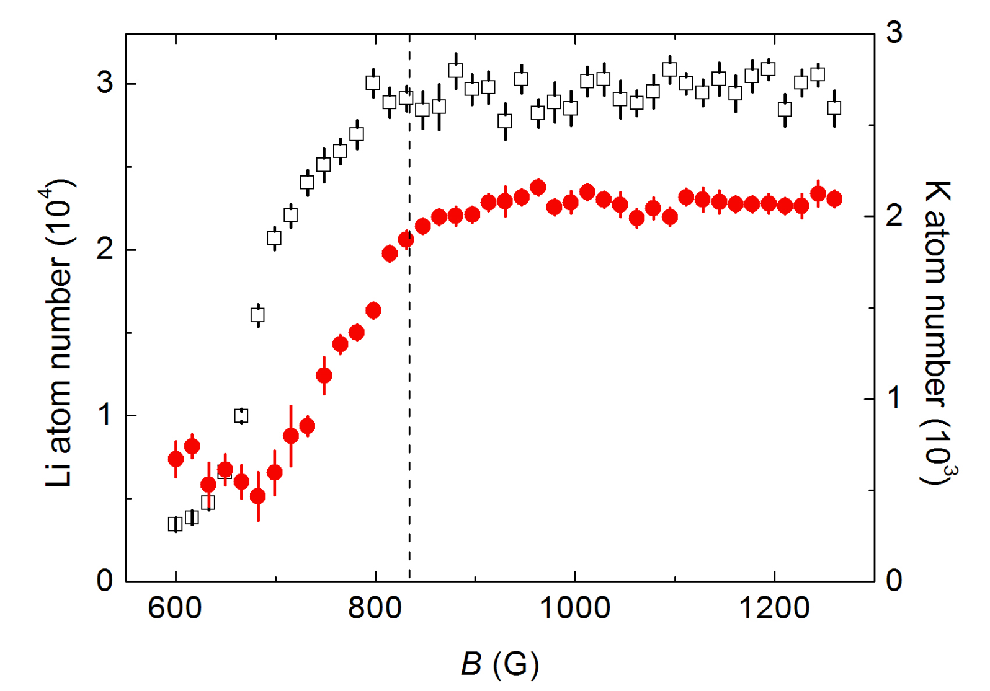
Loss from 3-fermion mixture
Atomnumbers after 1 second hold
Li
K
Notes:
K immersed in ten times bigger bath of Li
Stable.
Even in BEC region with molecules, K loss not dramatically worse than Li loss

Slide 14
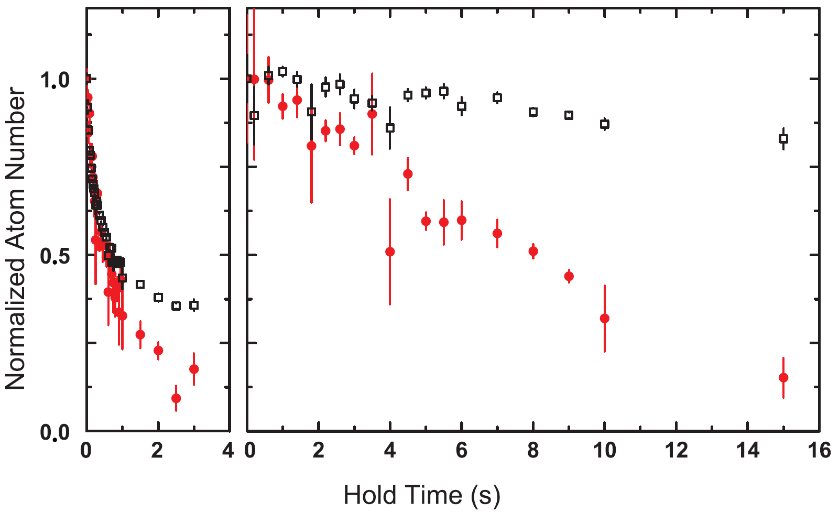
Sample decay data
B = 665 G
B = 834 G
Li
K

Slide 15
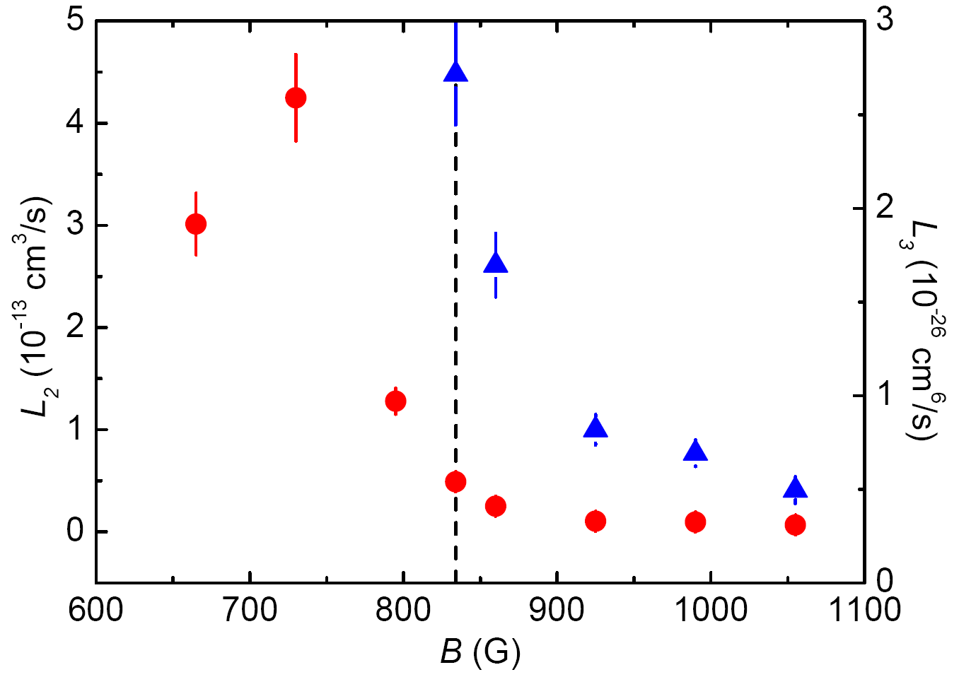
Loss rate coefficients
two-body
three-body
Notes:
Discuss difference between two-body and three-body
Mention John Thomas work

Slide 16
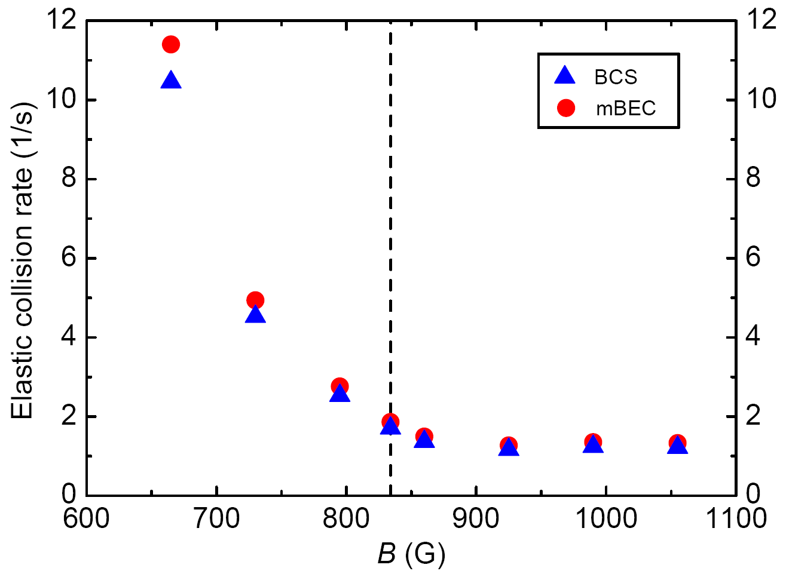
Elastic collision rates

Slide 17
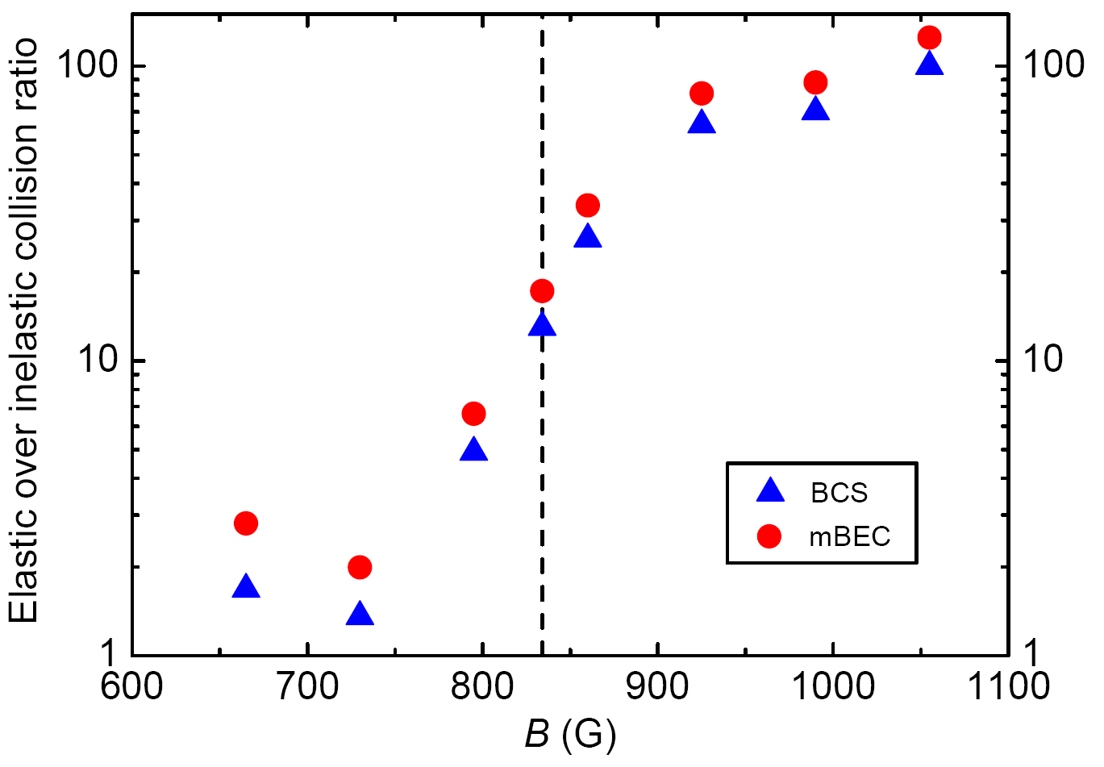
Good to bad collision ratio

Slide 18
Temperature measurement
PRL 95, 260405

Slide 19
A thermometer!

Slide 20
A thermometer!

Slide 21
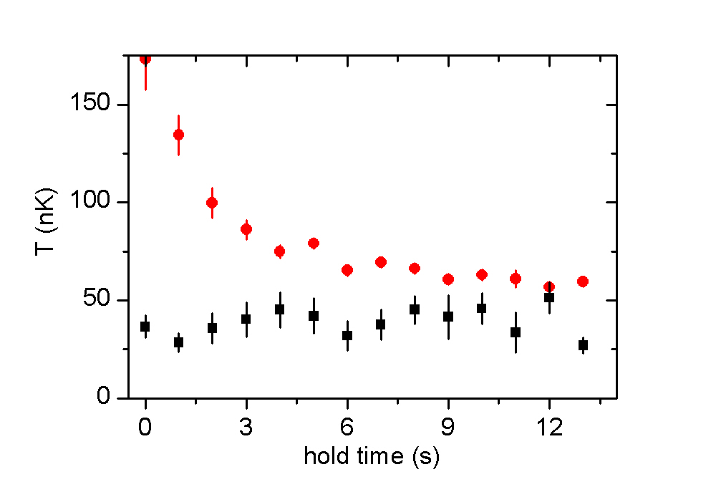
Thermalisation of K by Li
1190 G
Li
K

Slide 22
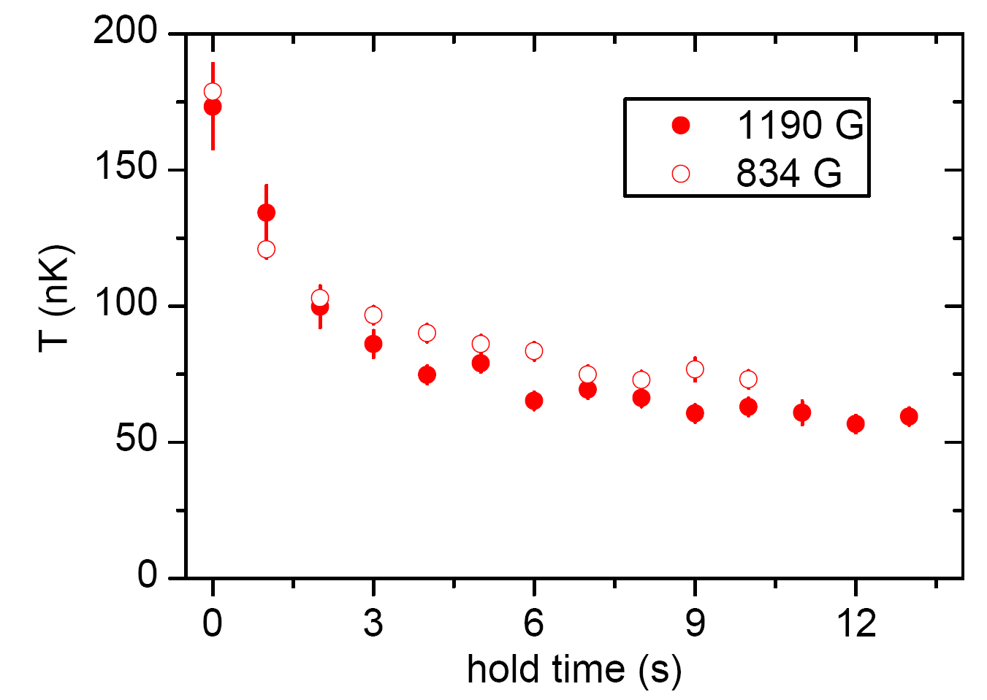
Thermalization at unitarity
⁴⁰K good probe for
strongly interacting Li!

Slide 23

Cs
Interspecies
Feshbach resonances

Slide 24
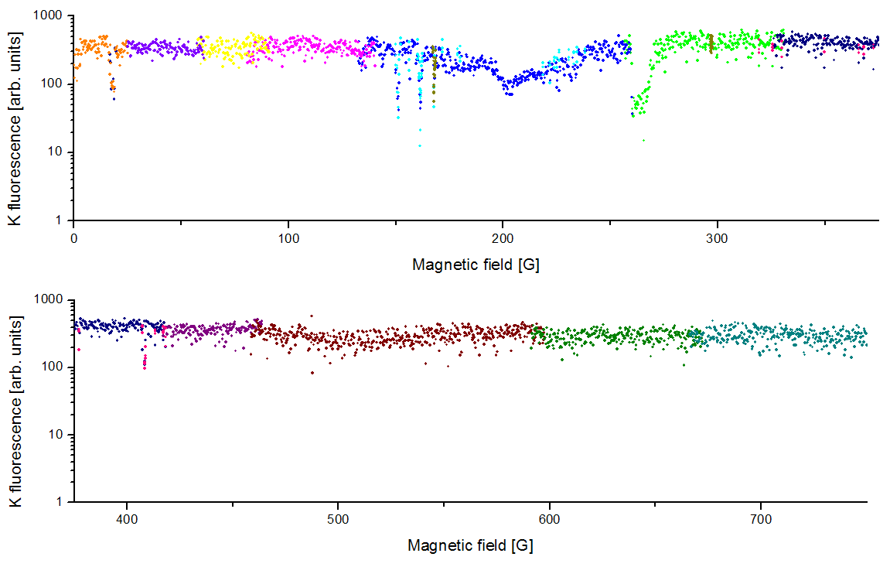
Li|1> K|2> scan
interspecies
K|2> only
Notes:
4 mixtures scanned
2601 measurement points per mixture
10404 experimental runs
174 hours

Slide 25
Interspecies Feshbach resonances
B [G]
channel position [G] width [G]
Li|2> + K|1> 215.6 1.7
Li|1> + K|1> 157.6 1.7
Li|1> + K|1> 168.2 1.2
Li|1> + K|1> 249 11
Li|1> + K|2> 16.1 3.8
Li|1> + K|2> 149.2 1.2
Li|1> + K|2> 159.5 1.7
Li|1> + K|2> 165.9 0.6
Li|1> + K|2> 263 11
Li|1> + K|3> 141.7 1.4
Li|1> + K|3> 154.9 2.0
Li|1> + K|3> 162.7 1.7
Li|1> + K|3> 271 14
- „asymptotic bound state“ model by S. Kokkelmans, T. Tiecke and J. Walraven
- coupled channels calculation by P. Julienne, E. Tiesinga
- coupled channels calculation by E. Tiemann

Slide 26
Predicted s-wave resonances
s-wave Feshbach resonances with K in lower HF state:
s-wave Feshbach resonances for stable mixtures:
All predicted s-wave Feshbach resonances:
measured
Results from simple „asymptotic bound state“ model
by S. Kokkelmans, T. Tiecke and J. Walraven

Slide 27
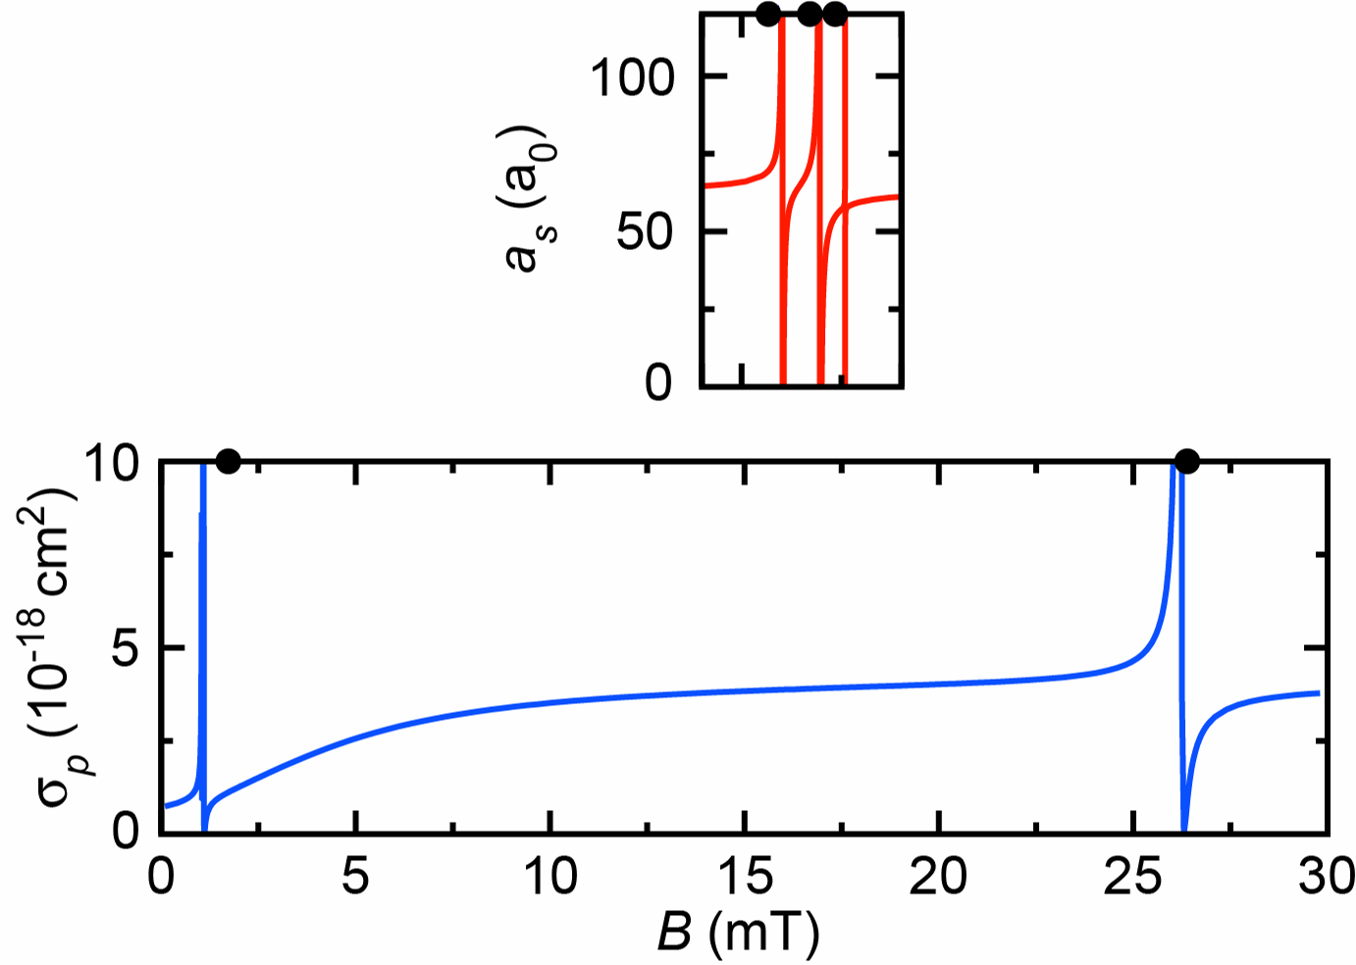
Li|1> K|2> scattering length
Coupled channels calculation by
Eite Tiesinga and Paul Julienne
Kai Dieckmanns
group
heteronuclear
molecules!
interaction
tuning !
singlet scattering length a_{s} = 52.1 a₀
triplet scattering length a_{t} = 63.5 a₀

Slide 28
Cs
Heteronuclear
Fermi-Fermi molecules

Slide 29
LiK Molecules
E
Li|2>
K|2>
Li|1>K|1>
B
Produce molecules by adiabatic magnetic field ramp (see K. Dieckmann)
Transfer remaining free atoms to different m_{F} state by π-pulse
Image molecules and free atoms using m_{F} state selective absorption imaging

Slide 30
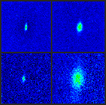
LiK Molecules
Potassium images
Lithium images
LiK molecules
N~1500
free atoms
168 G Li|1>K|1>
Feshbach resonance
N_{Li}= 5 10⁴
N_{K}= 5 10³

Slide 31
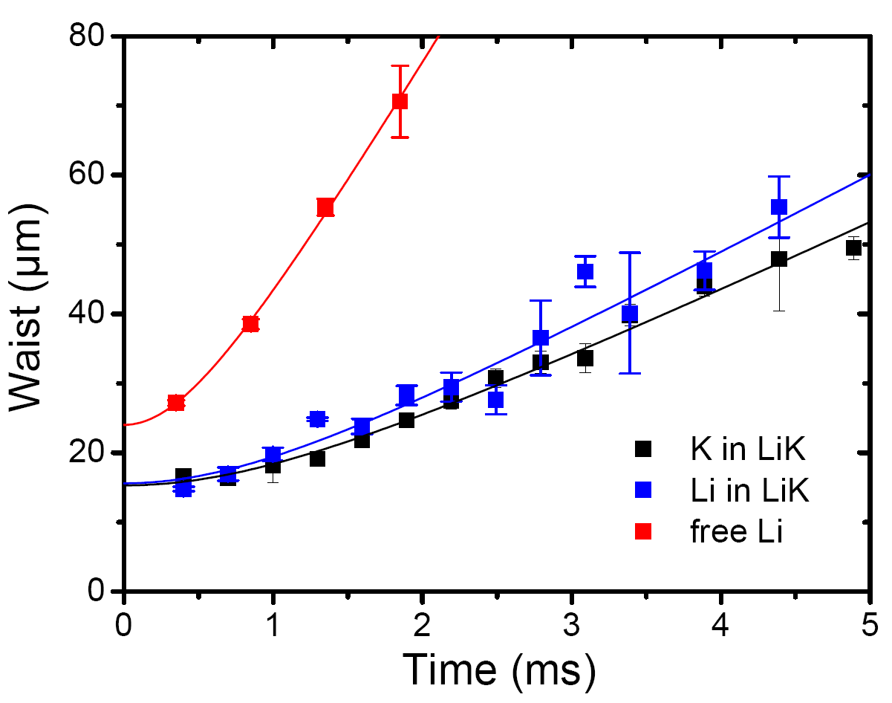
LiK Molecules

Slide 32
Outlook
Use ⁴⁰K as probe for Li BEC-BCS crossover
Explore strongly interacting Li K mixtures

Slide 33
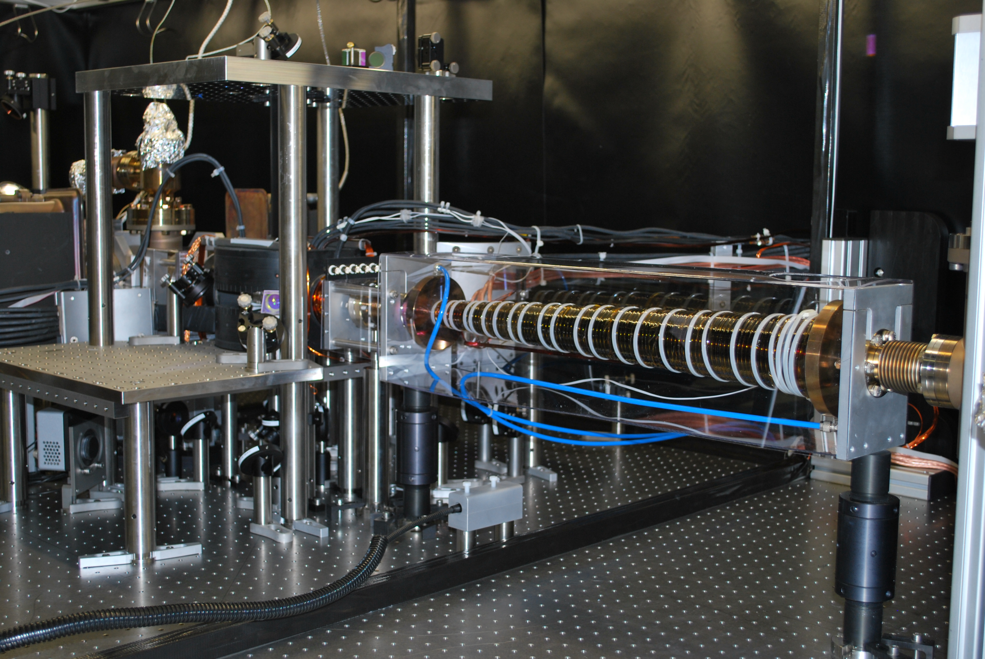
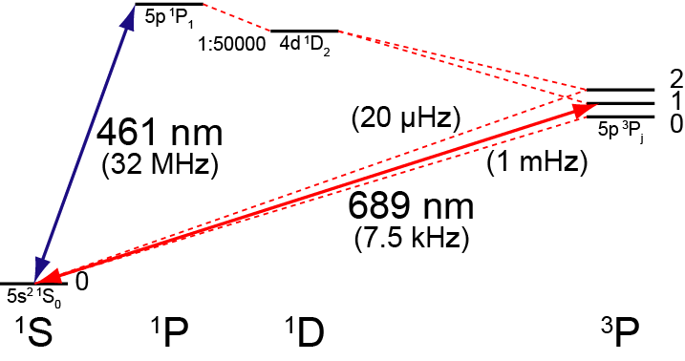
Towards a BEC of Sr

Slide 34
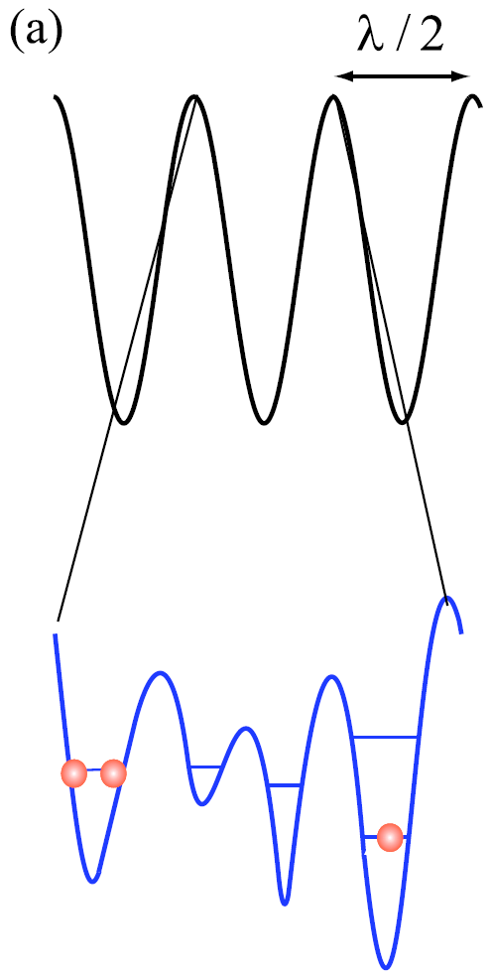
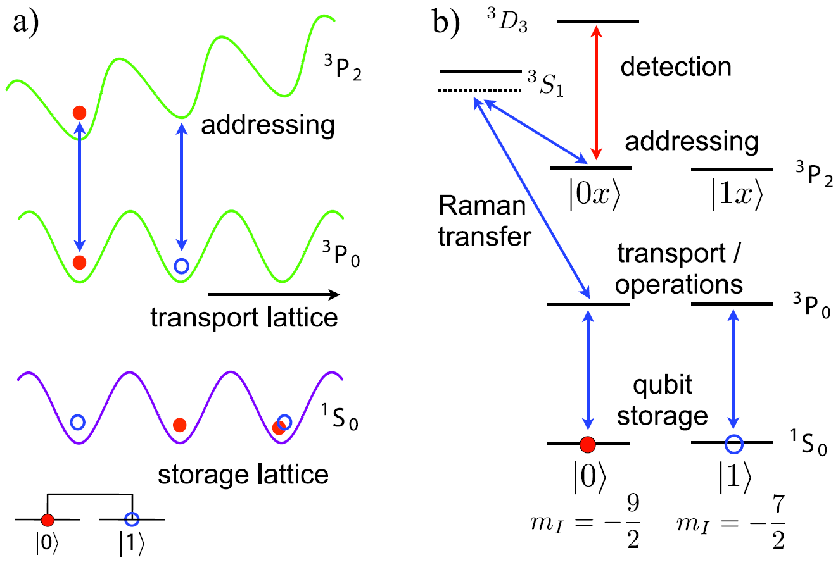
Towards a BEC of Sr
Subwavelength
optical lattices
Scheme for quantum information processing
arXiv:0808.1940
New J. Phys. 10, 073015

Slide 35
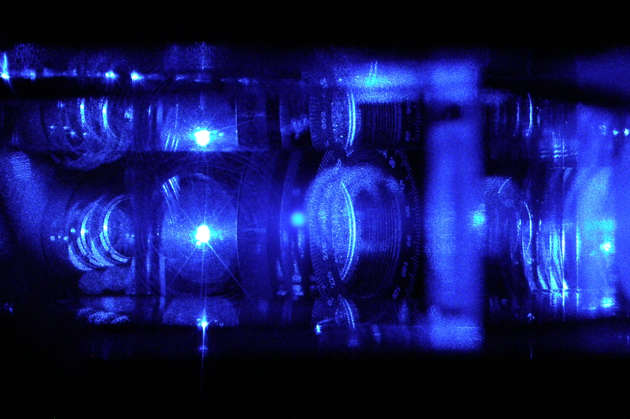
Towards a BEC of Sr
⁸⁸Sr MOT

Slide 36
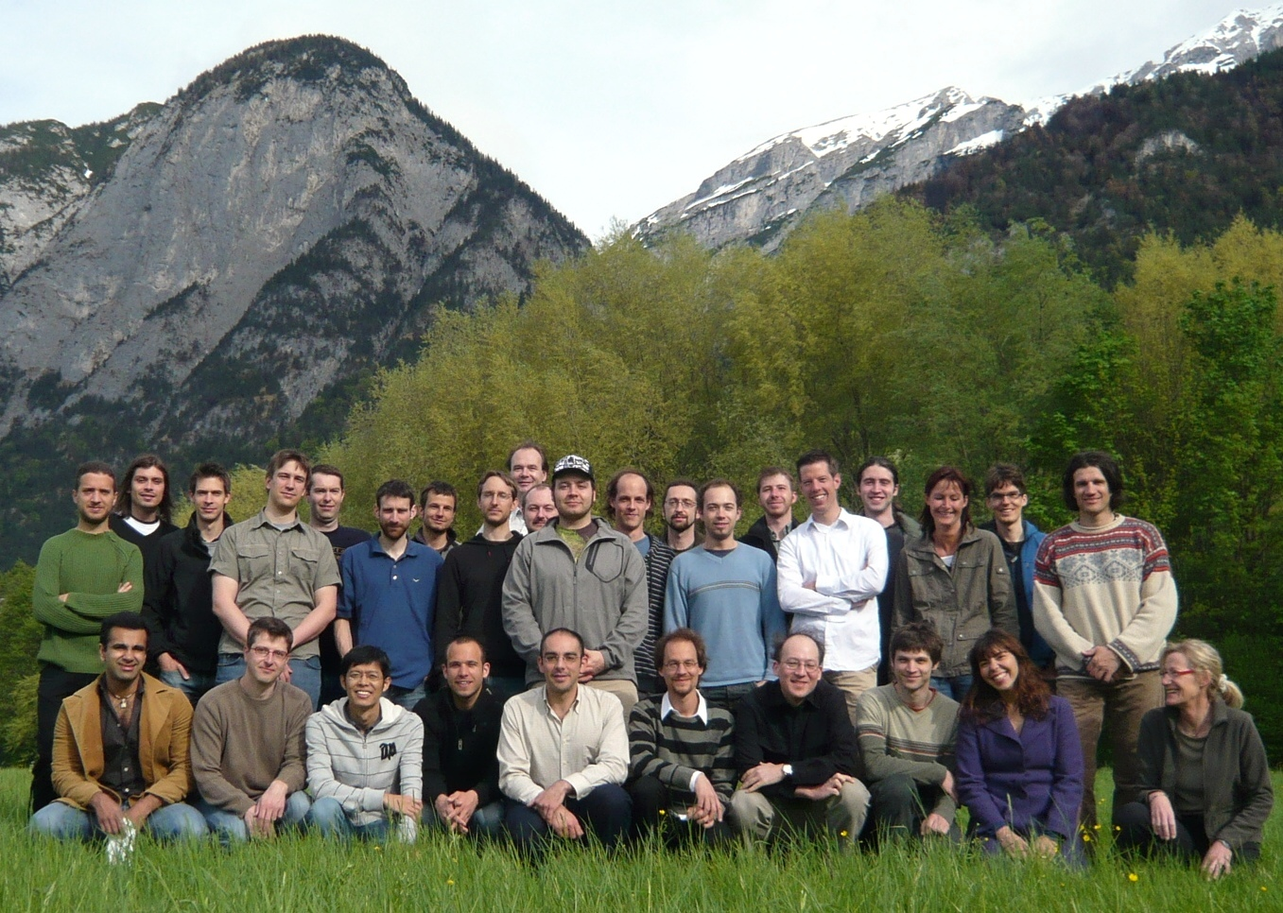
The ultracold group
Lithium Potassium Project
Strontium Project

